Slide 1

Security for All
Our Team
Michael Awad
Cade Krousie
Jubilee Borsay
EasySec

Slide 2
OUR MISSION
At EasySec, we empower small banks and pharmacies in Iowa with affordable, accessible cybersecurity solutions to protect their businesses and customers.
Small Business Security, Big Business Results.

Slide 3

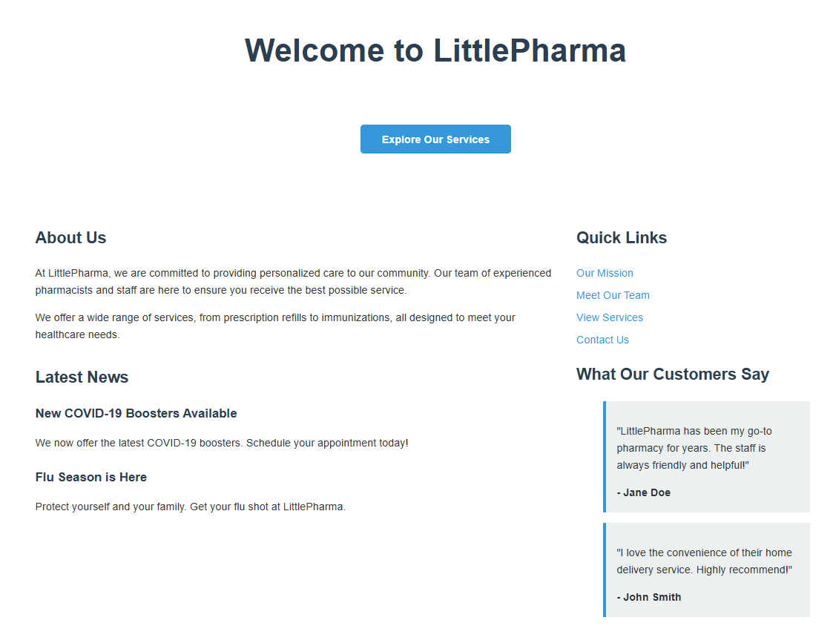


Est. 2005

Slide 4
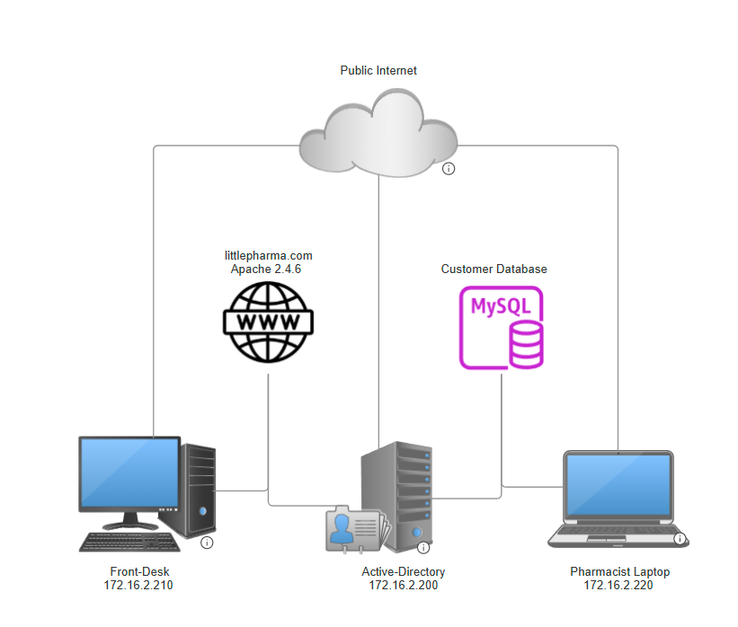

Slide 5




Setbacks
Sensitive Customer Data
Outdated Technology
Insecure Network
Overworked IT staff

Slide 6
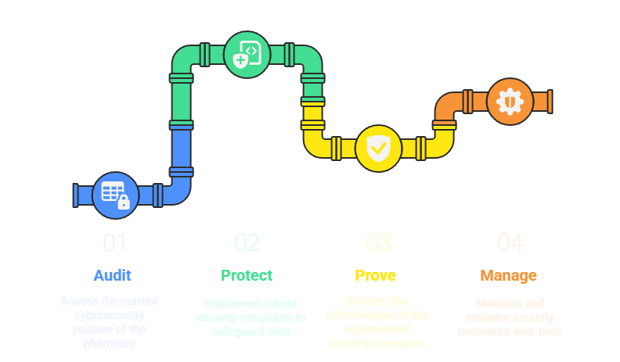
Our Solution

Slide 7
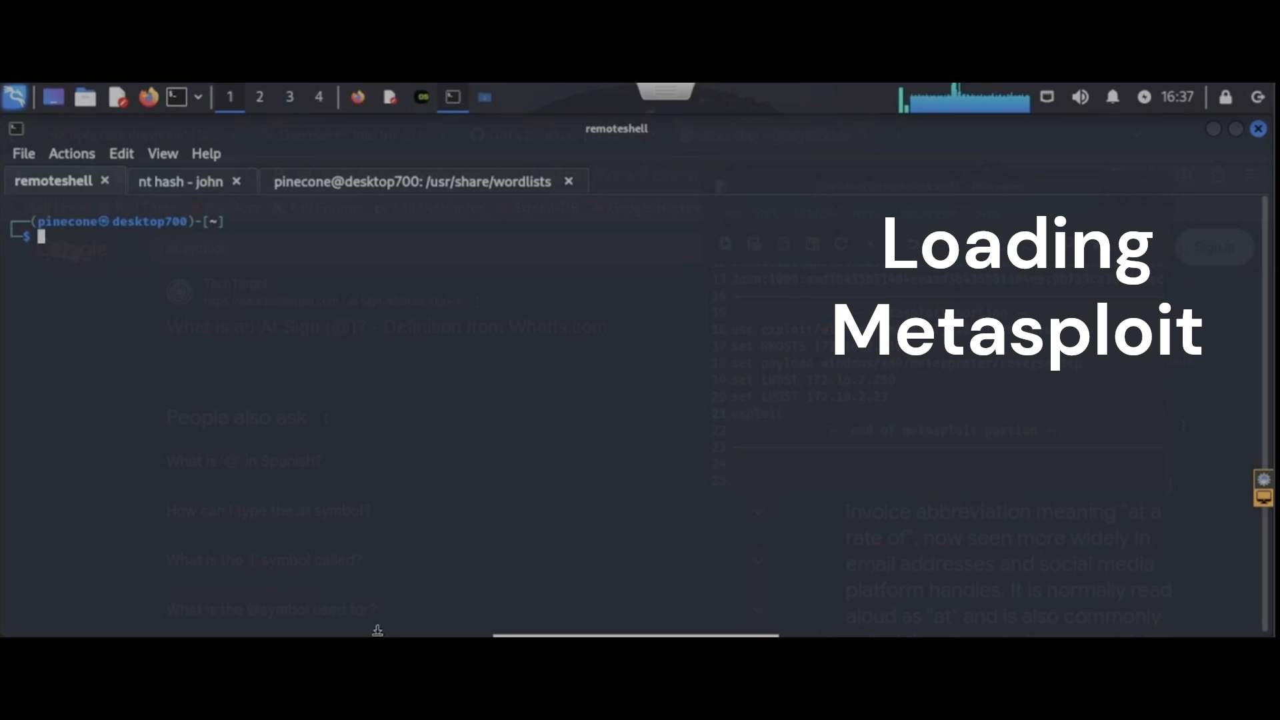
Phase 1
Audit
Vulnerable Laptop
(Windows 7)
Foothold
Lateral Movement

Slide 8
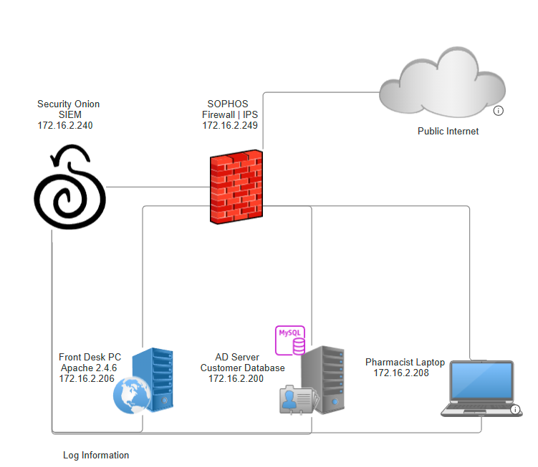
Phase 2
Protect
Update & Patch Systems
Implement Custom Domain GPOs (Group Policy)
Harden Access Controls

Slide 9


Recon
Exploitability
Lateral Movement Risk
Credential Management
Data Security
Phase 3
Prove

Slide 10
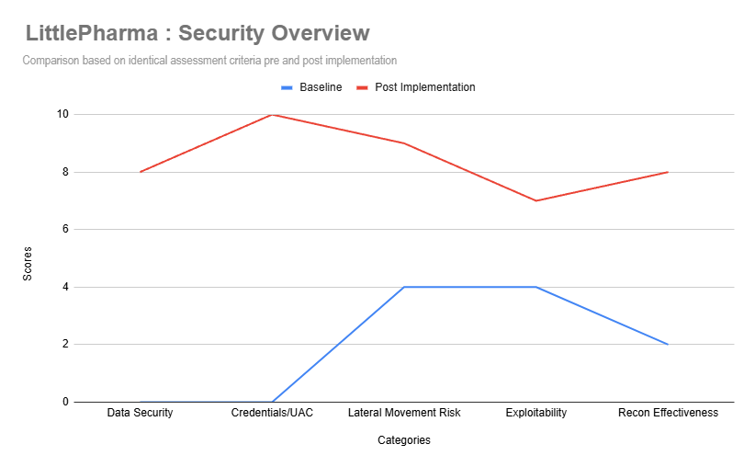
Post-Implementation
Improvement
320%
(Combined Scores)

Slide 11
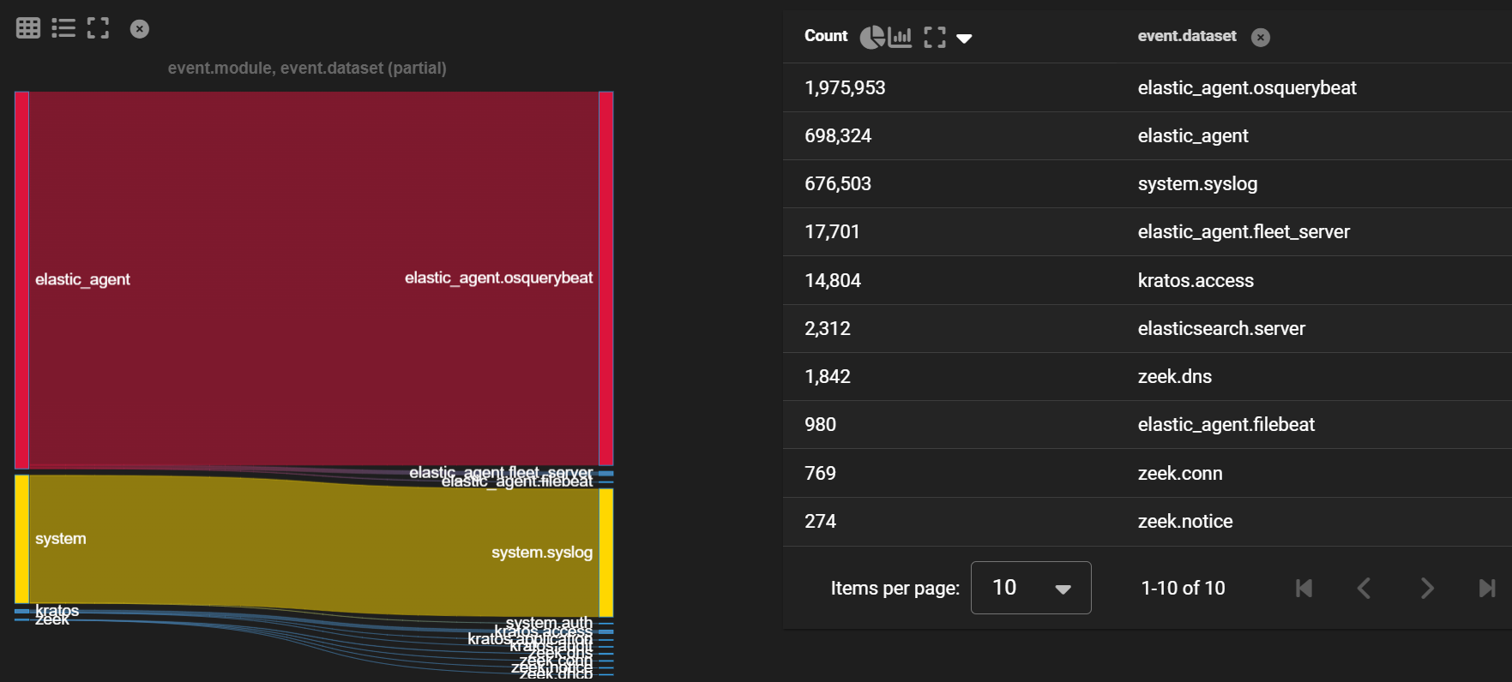
Real-Time Monitoring & Alerts
Manage your Network Traffic
Request Changes at any Time
Phase 4
Management

Slide 12

Password Management
Strict Password Policy
Credential Guard (GPO)

Slide 13


Tiers | Bronze | Silver | Gold
Password Management
Training Documentation
Open-Source Software
Commercial Software
Custom Solution
Installation Price | $2,500 | $4,000 | $8,000
Annual Management Price* (Per Site) | $36,000 | $50,000 | Call for Consultation
* Pricing does not include software licenses. Licensing fees are to be paid for by the client

Slide 14
Support Plans
Response Time | Bronze | Silver | Gold
Mission Critical | < 6 Hours | < 3 Hours | < 1 Hour
System Impaired | < 12 Hours | < 8 Hours | < 3 Hours
General Guidance | < 24 Hours | < 12 Hours | < 8 Hours
Support Line | 8AM-5PM | 8AM-5PM | 24 Hour
Consultations | 2/Year | 2/Year | 4/Year

Slide 15

Employee Training Package
Included Free for All Tiers
Some concepts include :
Phishing Prevention
Social Engineering
Responsible day-to-day use of computers.

Slide 16
“We’re too small to worry about Cybersecurity!”
Small Businesses are easy targets
YOUR customer data is worth big $$$
Cost of a Data Breach ~$4.88Million (IBM)

Slide 17

We’ve Got Your Back
We do our job so you can focus on yours.
Let us worry about…
Midnight Emergencies.
Data Security
Cyber Defense
Services@easysec.com

Slide 18


Thank You For Listening!
Find Us On LinkedIn!
CadeKrousieIT
MichaelAwadIT
JubileeBorsayIT

